Slide 1

Introduction to Deep Learning
Angelica Sun
(adapted from Atharva Parulekar, Jingbo Yang)

Slide 2
Overview
Motivation for deep learning
Convolutional neural networks
Recurrent neural networks
Transformers
Deep learning tools

Slide 3
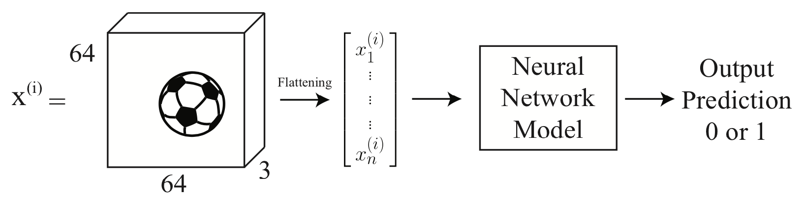

But we learned multi-layer perceptron in class?
Expensive to learn. Will not generalize well.
Does not exploit the order and local relations in the data!
64x64x3=12288 parameters
We also want many layers

Slide 4
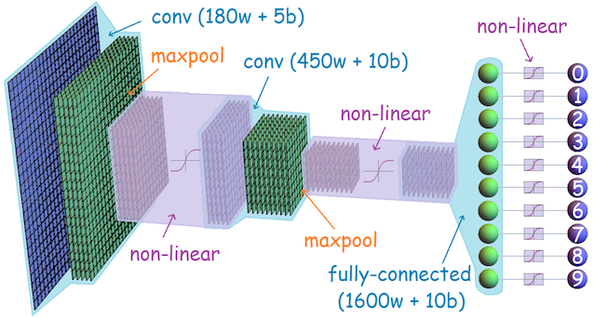
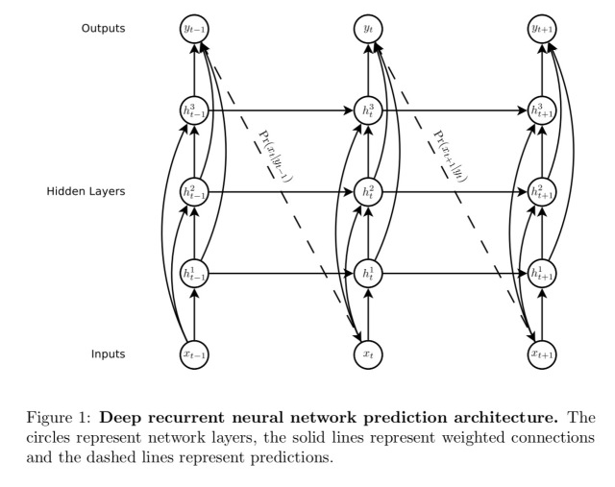
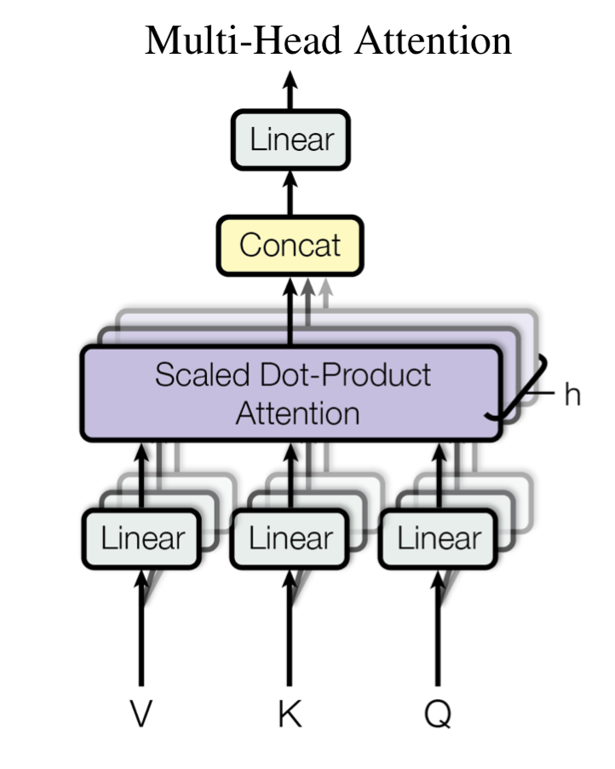

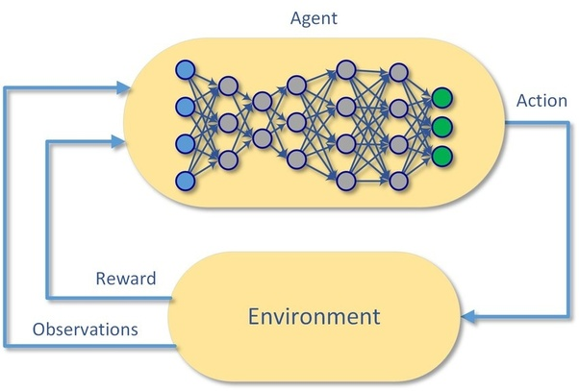
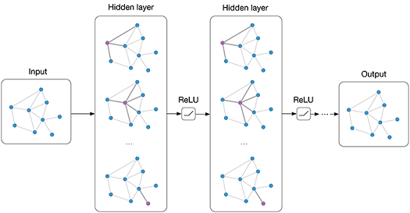
What are areas of deep learning?
Convolutional NN
Image
Recurrent NN
Sequential Inputs
Transformers
Parallelized Sequential Inputs
Graph NN
Networks/Relational
Deep RL
Control System

Slide 5
Starting from CNN
Convolutional
Neural Network

Slide 6
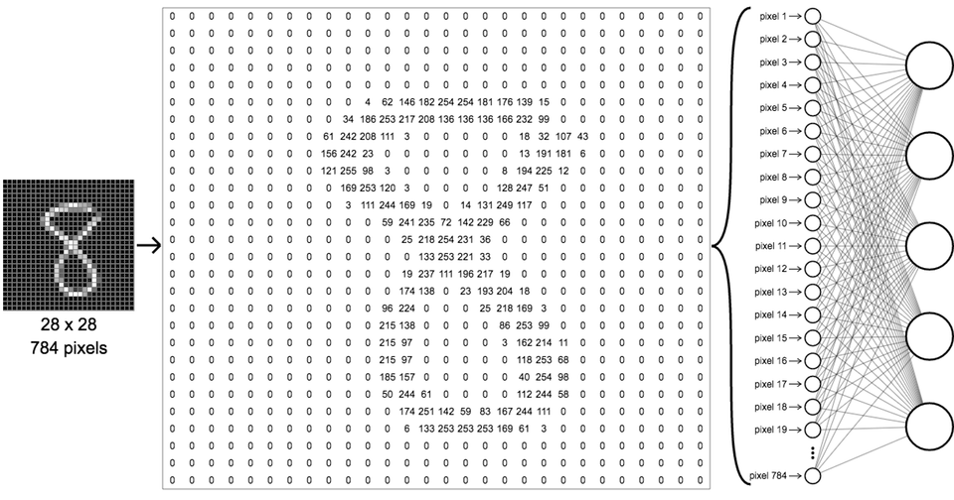
Let us look at images in detail

Slide 7
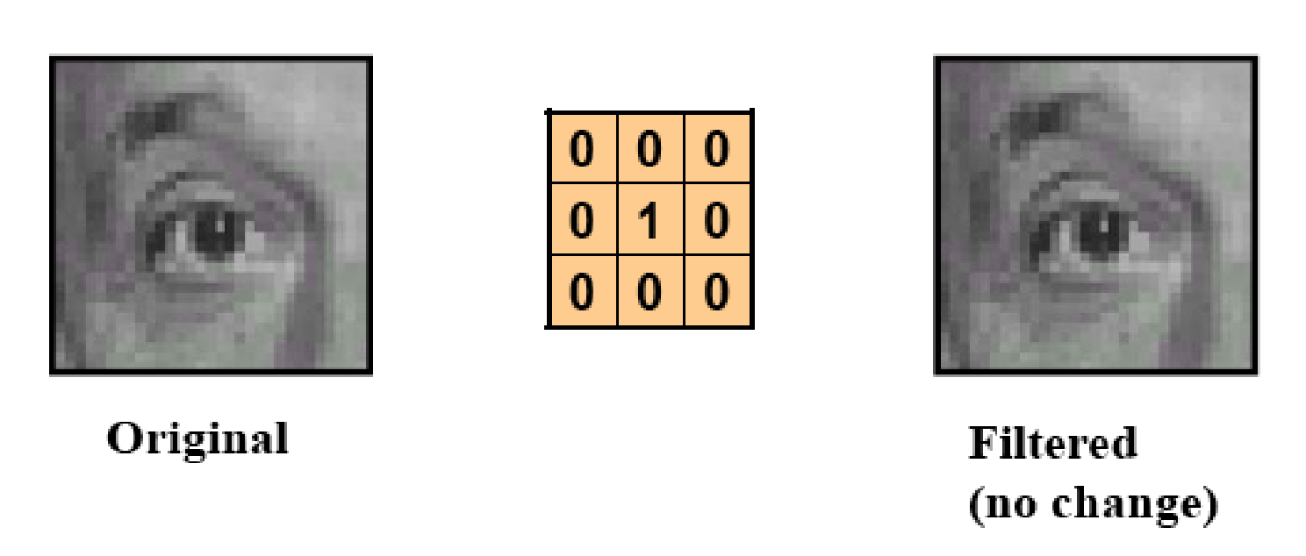

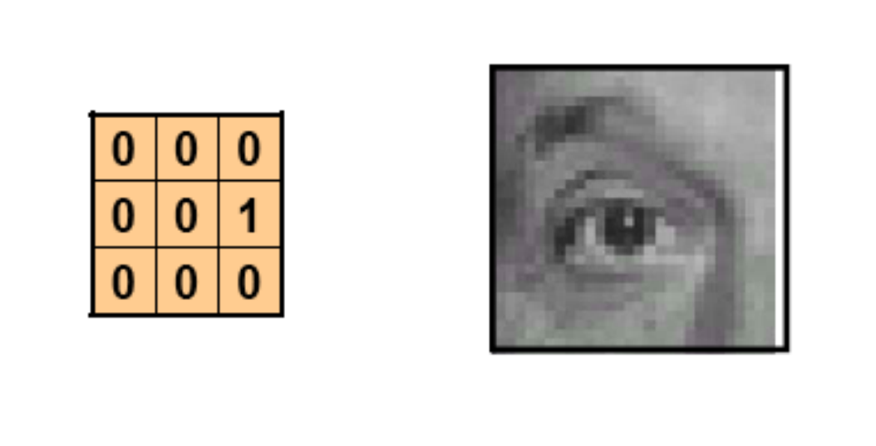
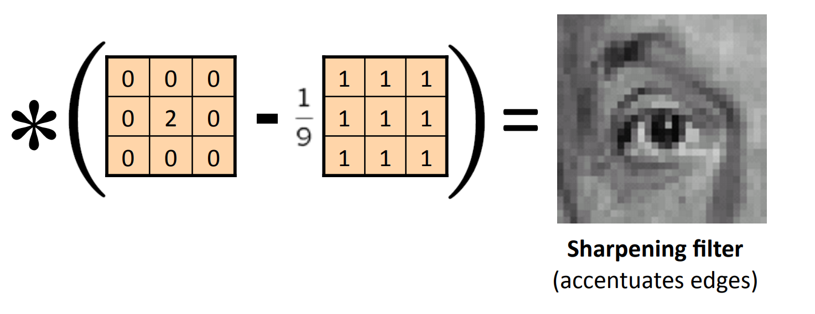
Filters in traditional Computer Vision
Image credit: https://home.ttic.edu/~rurtasun/courses/CV/lecture02.pdf

Slide 8

Learning filters in CNN
Why not extract features using filters?
Better, why not let the data dictate what filters to use?
Learnable filters!!

Slide 9
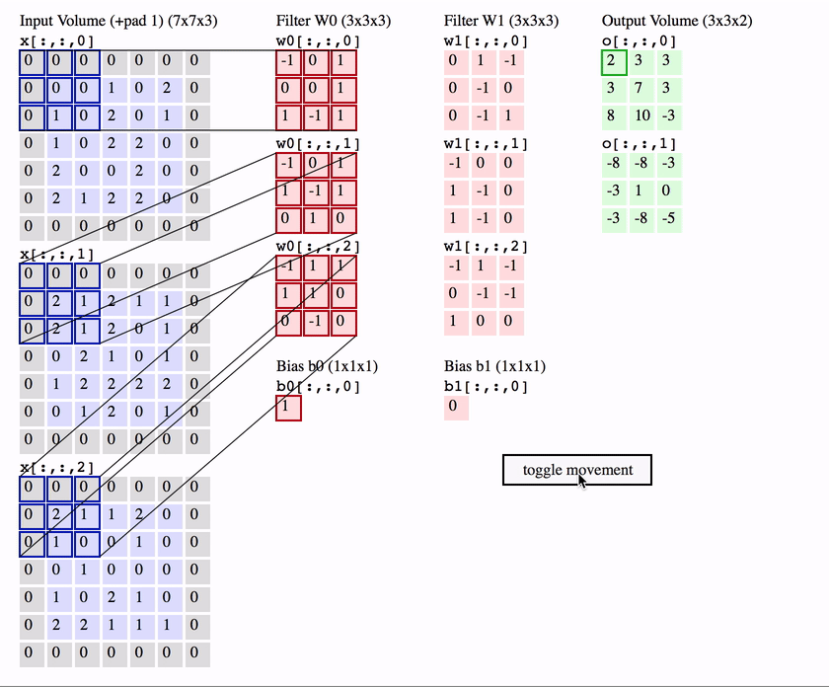
Convolution on multiple channels
Images are generally RGB !!
How would a filter work on a image with RGB channels?
The filter should also have 3 channels.
Now the output has a channel for every filter we have used.

Slide 10
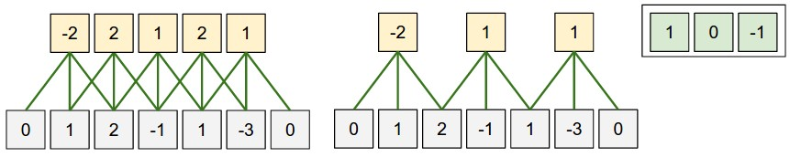
Parameter Sharing
Lesser the parameters less computationally intensive the training. This is a win win as we are reusing parameters.

Slide 11
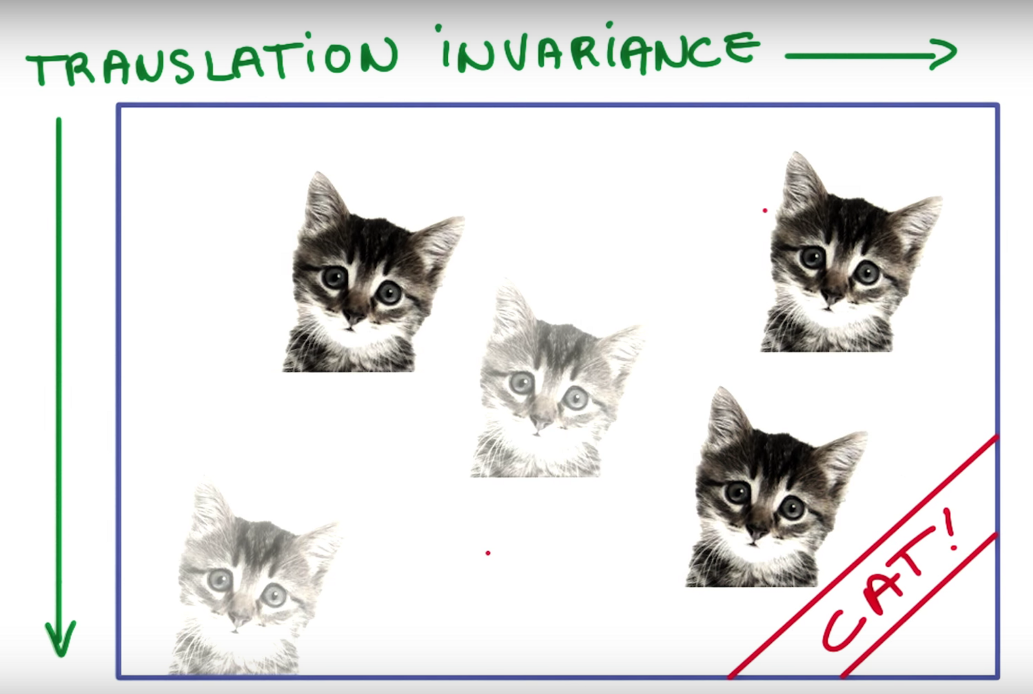
Translational invariance
Since we are training filters to detect cats and the moving these filters over the data, a differently positioned cat will also get detected by the same set of filters.

Slide 12
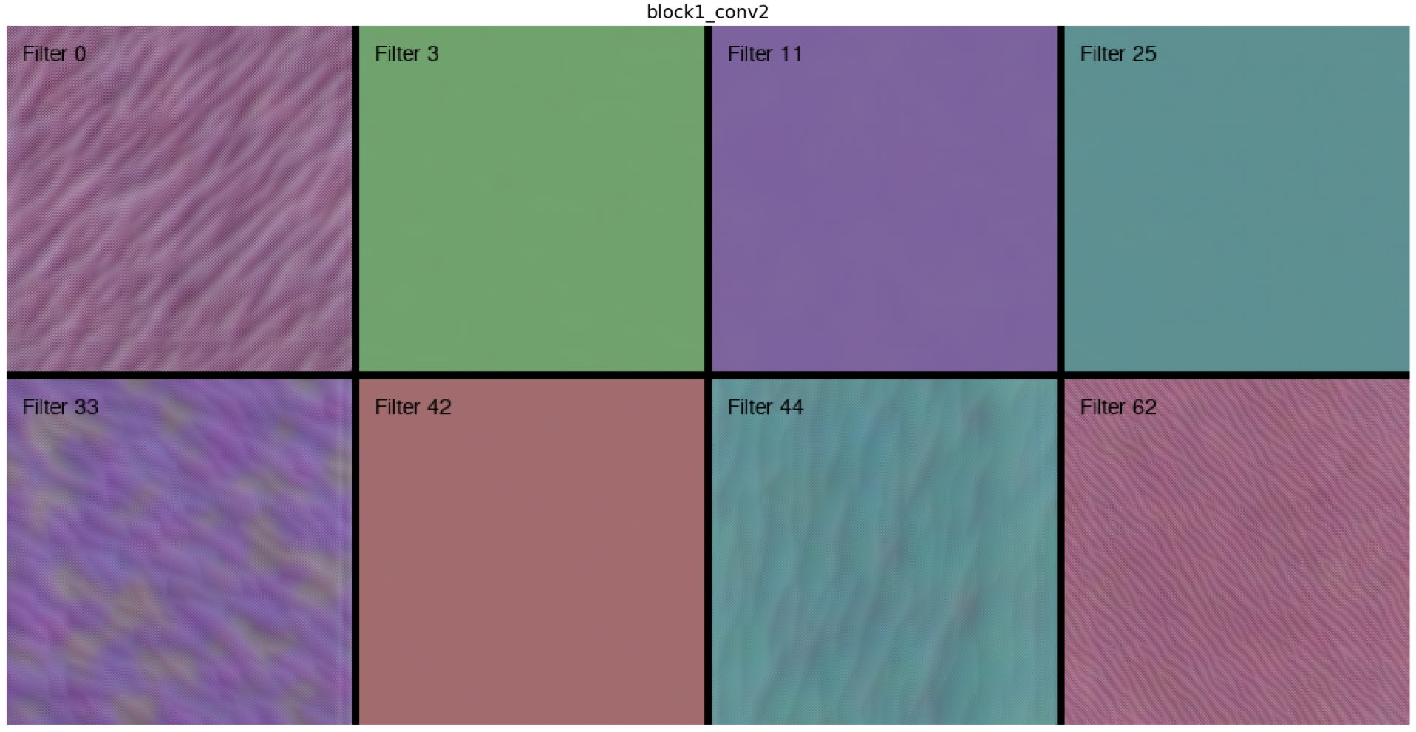
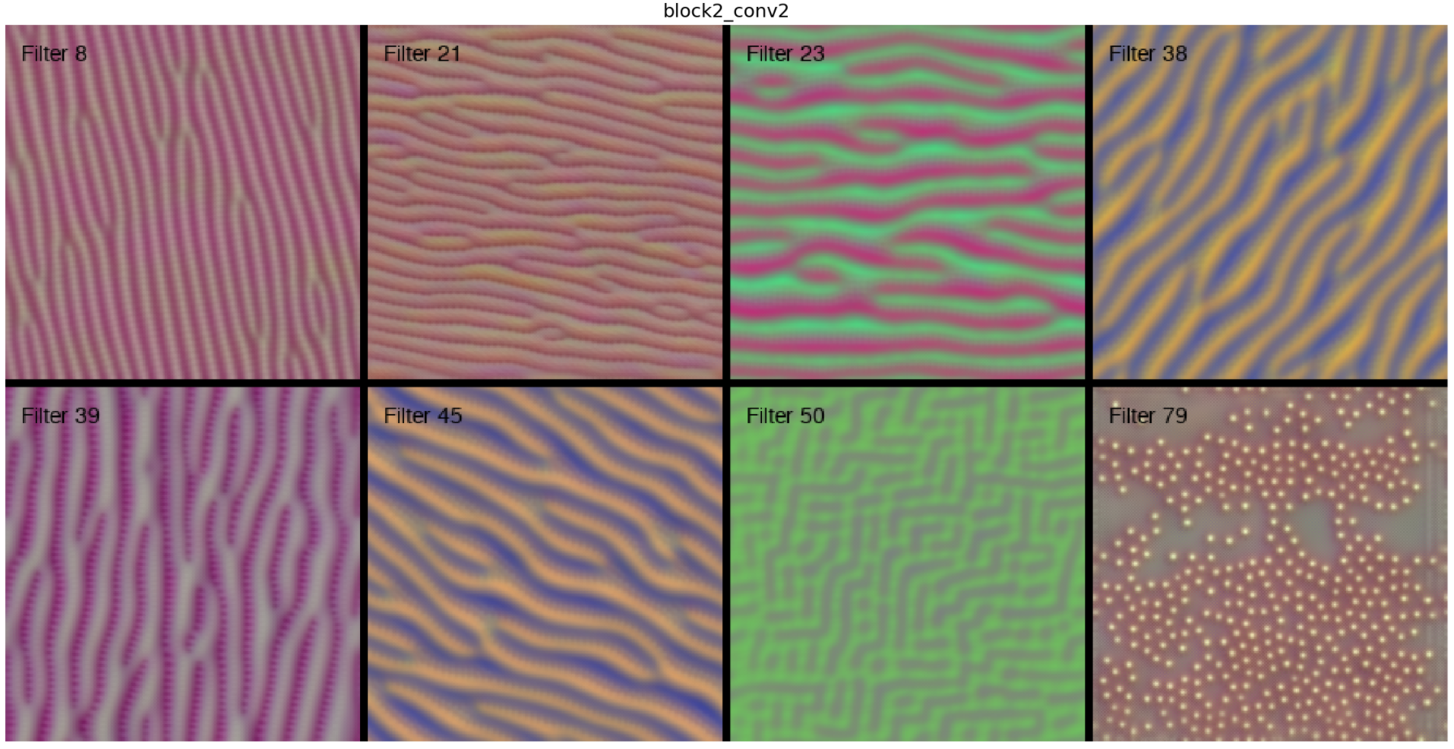
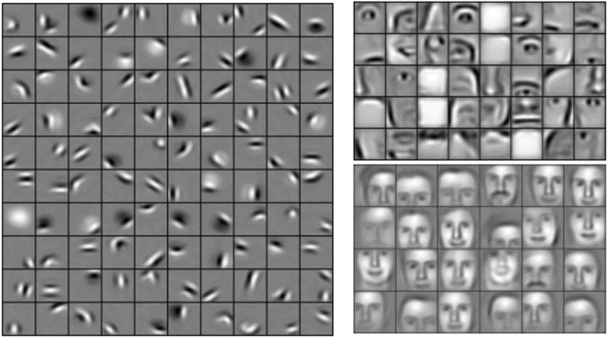
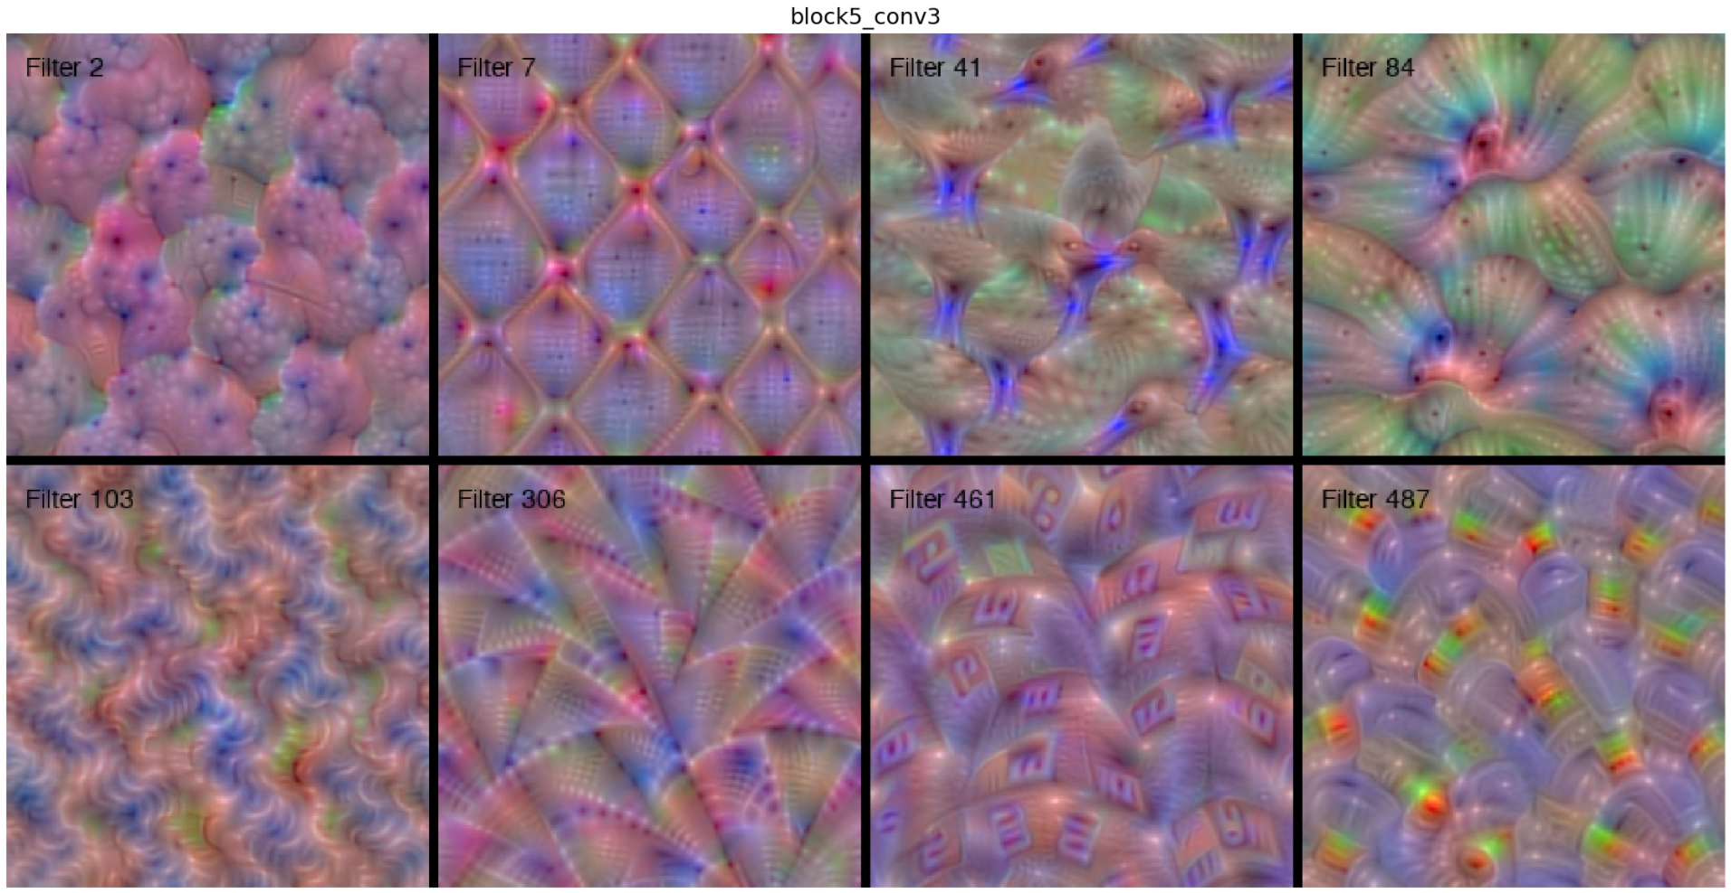
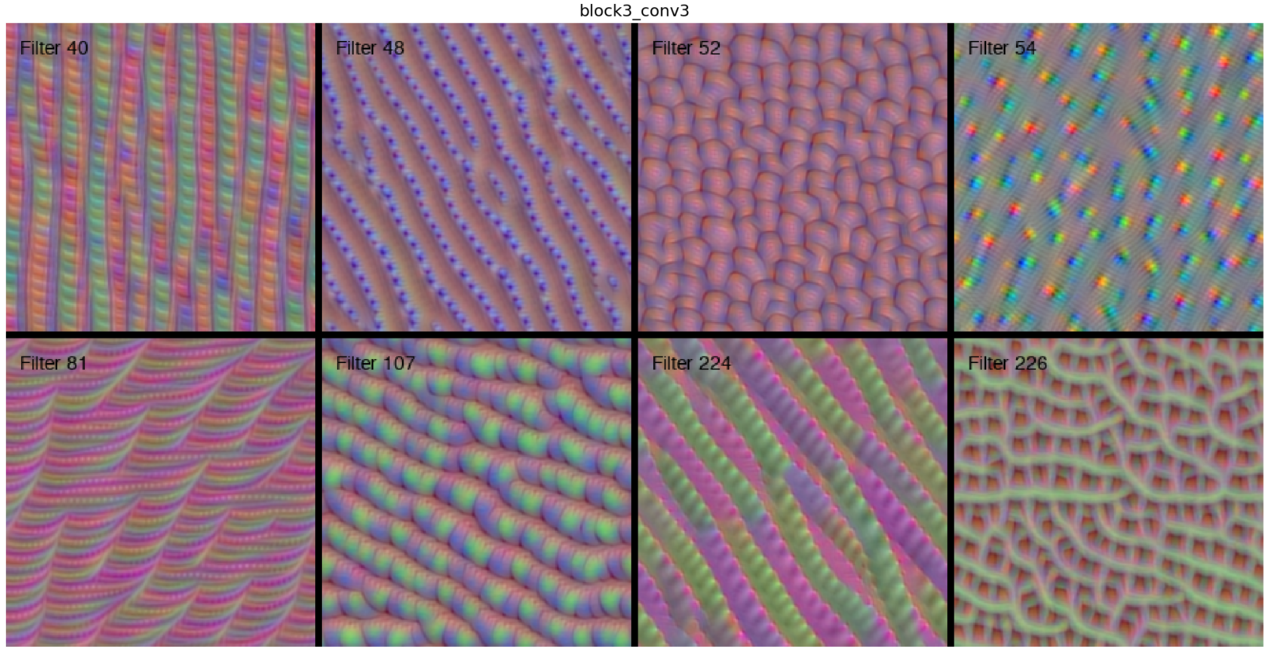
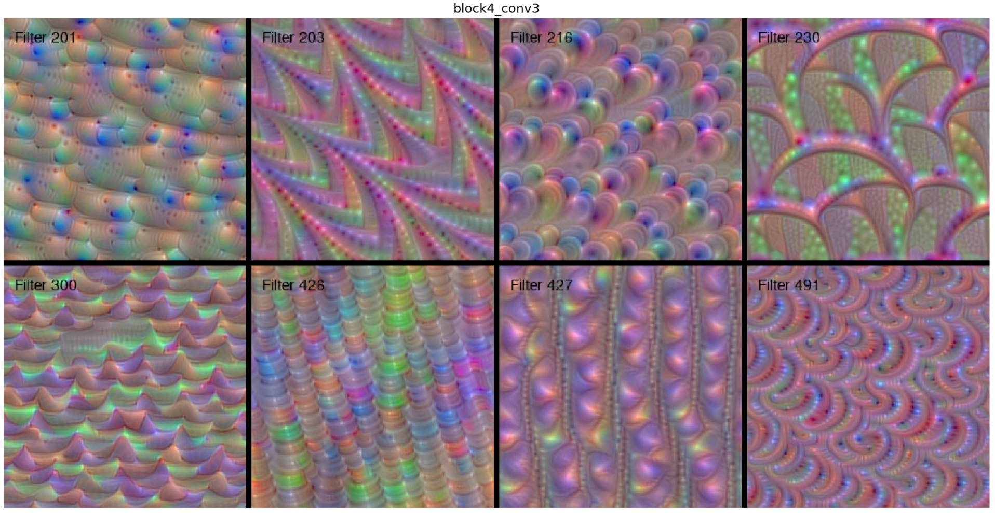
Visualizing learned filters
Images that maximize filter outputs at certain layers. We observe that the images get more complex as filters are situated deeper
How deeper layers can learn deeper embeddings. How an eye is made up of multiple curves and a face is made up of two eyes.

Slide 13
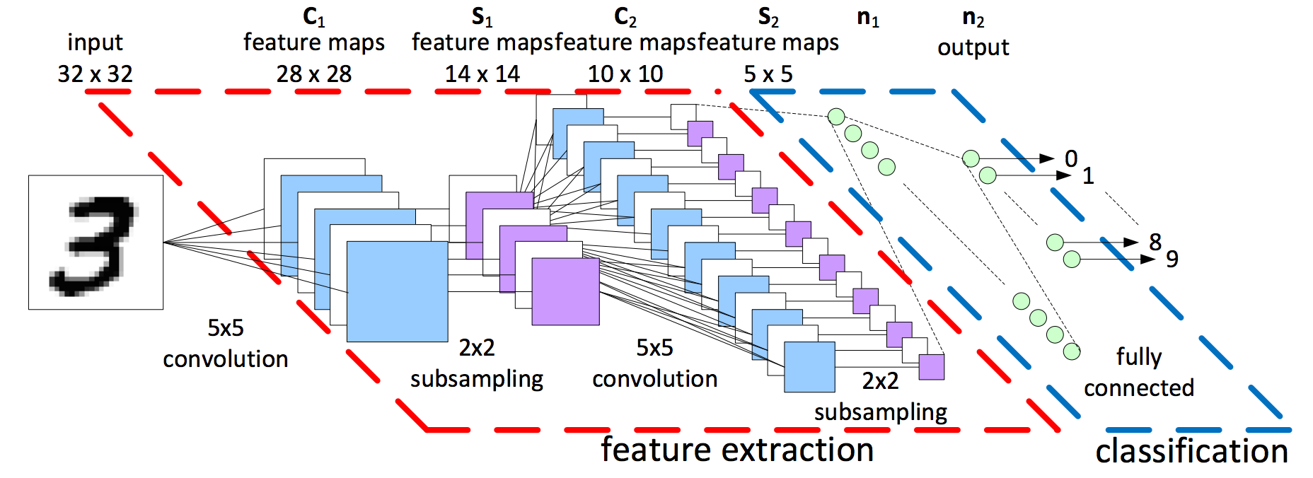
A typical CNN structure:
Image credit: LeCun et al. (1998)

Slide 14
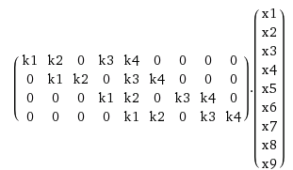
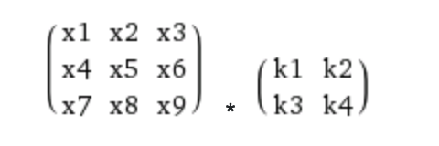
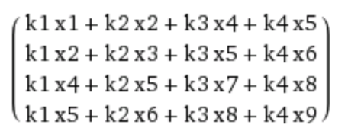
Convolution really is just a linear operation
In fact convolution is a giant matrix multiplication.
We can expand the 2 dimensional image into a vector and the conv operation into a matrix.

Slide 15
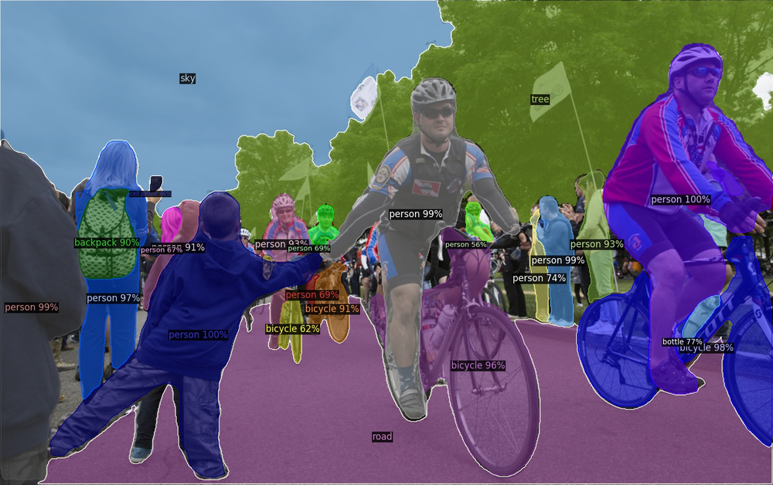
SOTA Example – Detectron2

Slide 16

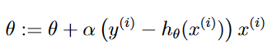

How do we learn?
Instead of
They are “optimizers”
Momentum: Gradient + Momentum
Nestrov: Momentum + Gradients
Adagrad: Normalize with sum of sq
RMSprop: Normalize with moving avg of sum of squares
ADAM: RMsprop + momentum

Slide 17
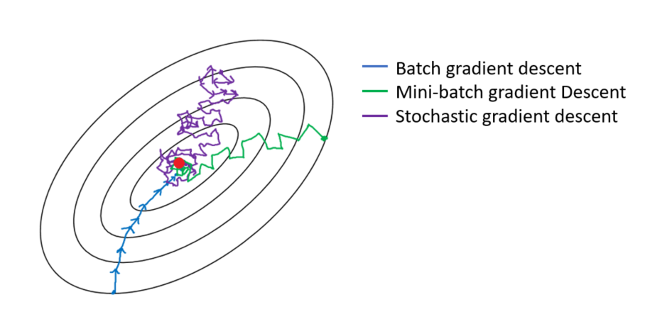
Mini-batch Gradient Descent
Expensive to compute gradient for large dataset
Memory size
Compute time
Mini-batch: takes a sample of training data
How to we sample intelligently?

Slide 18

Is deeper better?
Deeper networks seem to be more powerful but harder to train.
Loss of information during forward propagation
Loss of gradient info during back propagation
There are many ways to “keep the gradient going”

Slide 19
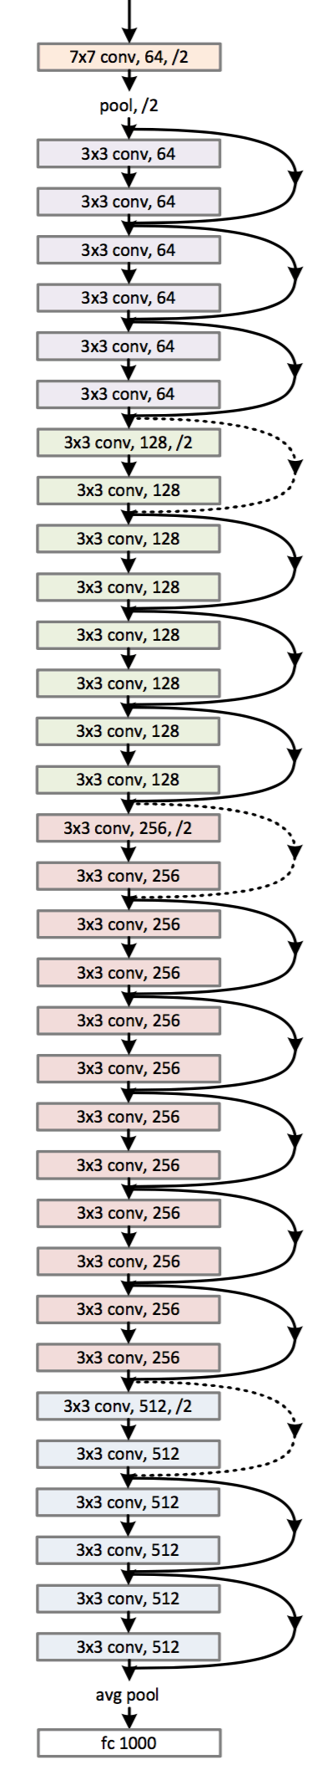
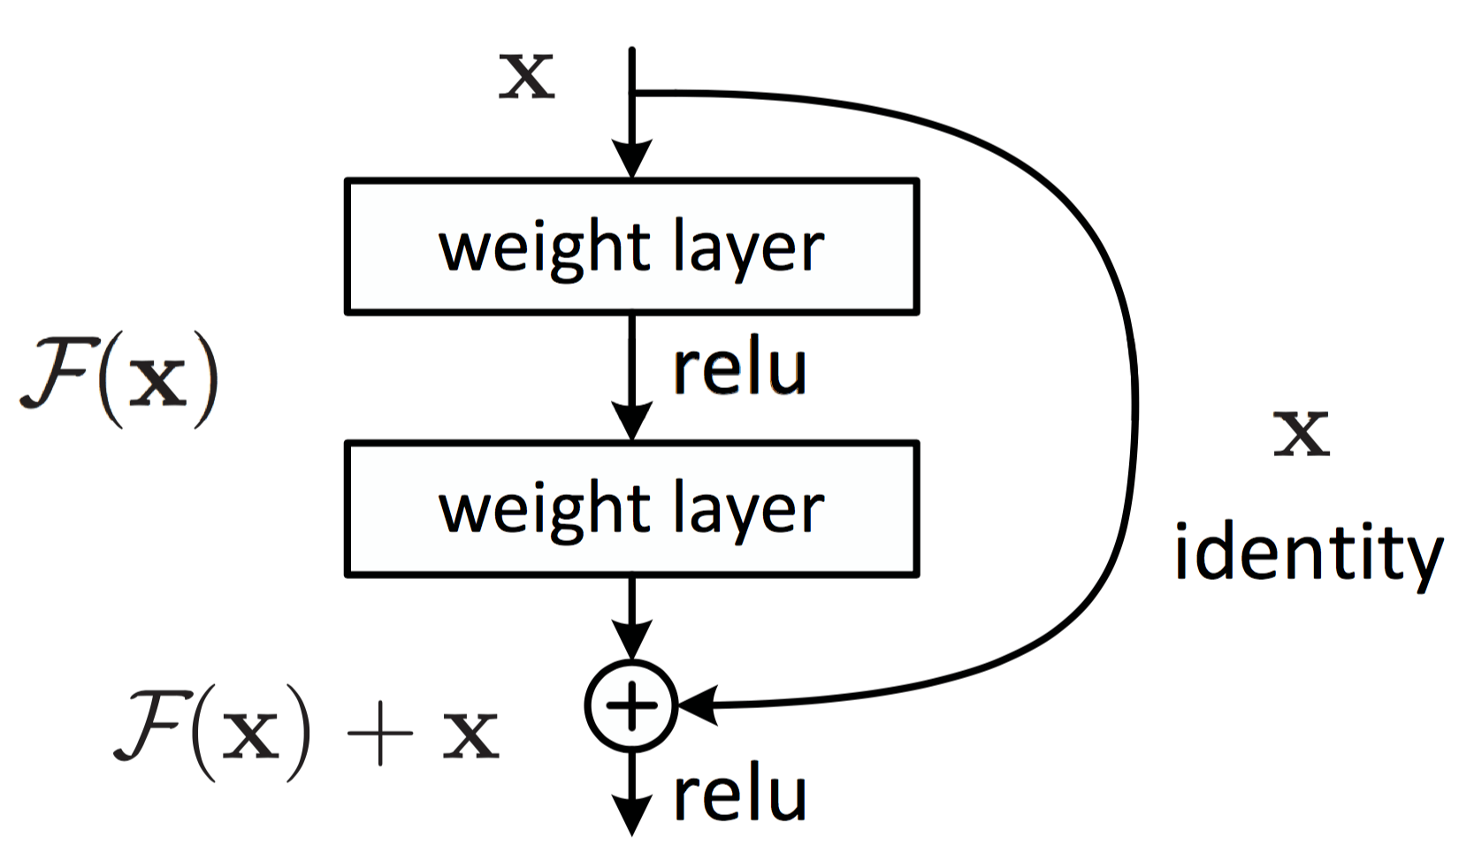
One Solution: skip connection
Connect the layers, create a gradient highway or information
highway.
ResNet (2015)
Image credit: He et al. (2015)

Slide 20
Initialization
Can we initialize all neurons to zero?
If all the weights are same we will not be able to break symmetry of the network and all filters will end up learning the same thing.
Large numbers, might knock relu units out.
Relu units once knocked out and their output is zero, their gradient flow also becomes zero.
We need small random numbers at initialization.
Variance : 1/sqrt(n)
Mean: 0
Popular initialization setups
(Xavier, Kaiming) (Uniform, Normal)

Slide 21

Dropout
What does cutting off some network connections do?
Trains multiple smaller networks in an ensemble.
Can drop entire layer too!
Acts like a really good regularizer

Slide 22
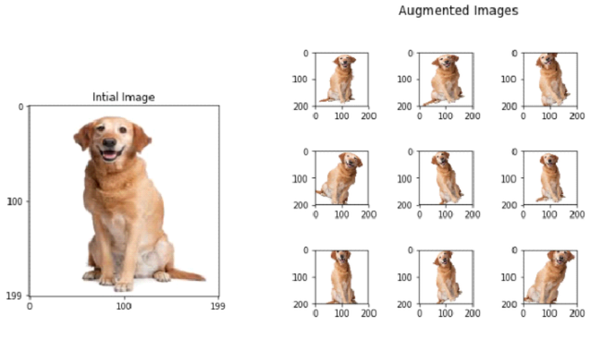
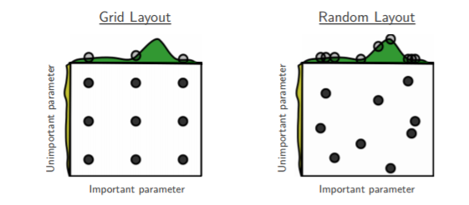
More tricks for training
Data augmentation if your data set is smaller. This helps the network generalize more.
Early stopping if training loss goes above validation loss.
Random hyperparameter search or grid search?

Slide 23
CNN sounds like fun!
What are some other areas of deep learning?
Recurrent NN
Sequential data
Convolutional NN
Deep RL
Graph NN

Slide 24
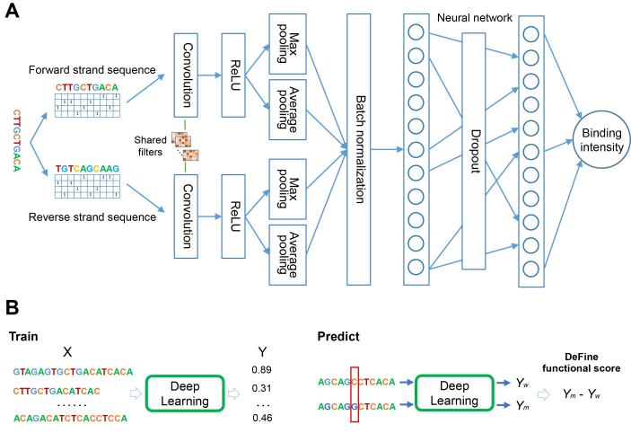
We can also have 1D architectures (remember this)
CNN works on any data where there is a local pattern
We use 1D convolutions on DNA sequences, text sequences, and music notes
But what if time series has causal dependency or any kind of sequential dependency?

Slide 25
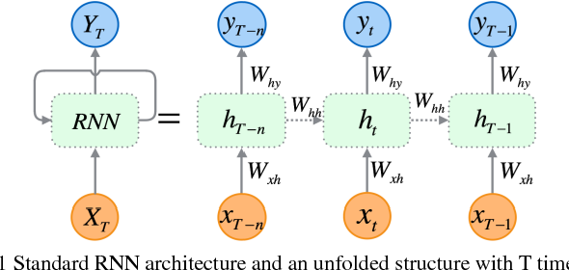
To address sequential dependency?
Use recurrent neural network (RNN)
Unrolling an RNN
Step output
Latent Output
RNN Cell
Input at one time step
The RNN Cell (Composed of Wxh and Whh in this example) is really the same cell.
NOT many different cells like the filters of CNN.

Slide 26
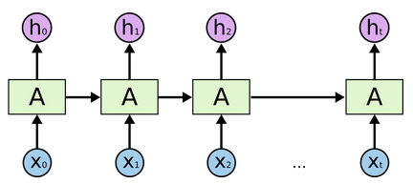
How does RNN produce result?
Evolving “embedding”
Result after reading full sentence
I love CS !

Slide 27
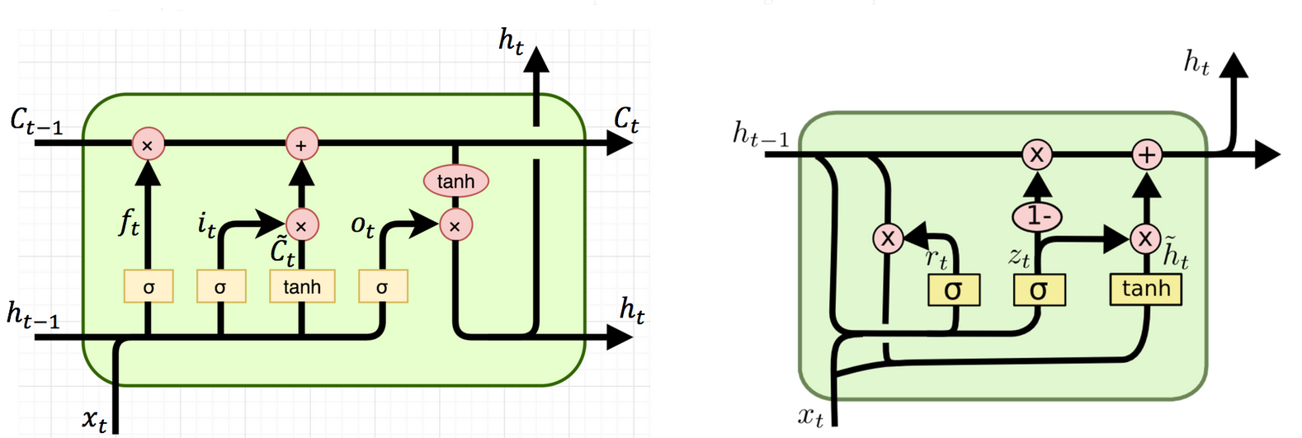
2 Typical RNN Cells
Store in “long term memory”
Response to current input
Reset gate
Update gate
Response to current input
Long Short Term Memory (LSTM)
Gated Recurrent Unit (GRU)

Slide 28
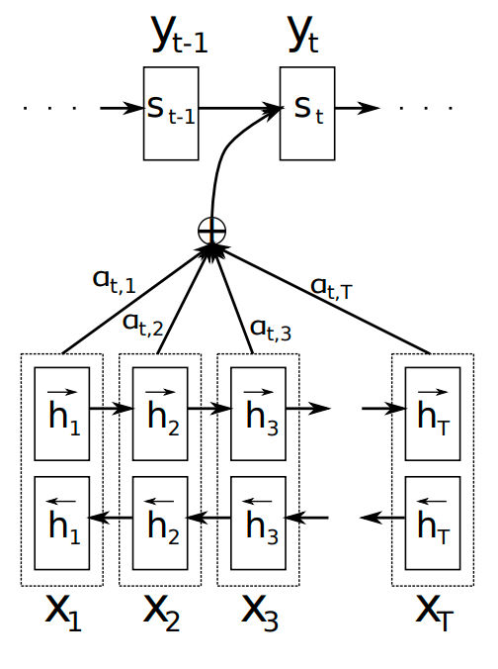
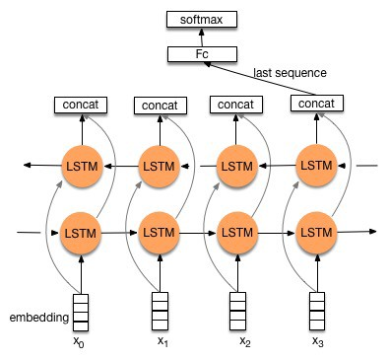
Recurrent AND deep?
Taking last value
Pay “attention” to everything
Stacking
Attention Model

Slide 29

Transformer – Attention is All You Need!
Originally proposed for translation.
Encoder computes hidden representations for each word in the input sentence
Applies self attention.
Decoder makes sequential prediction similar as in RNN
At each time step, it predicts the next word based on its previous predictions (partial sentence).
Applies self attention and attention on encoder outputs.

Slide 30
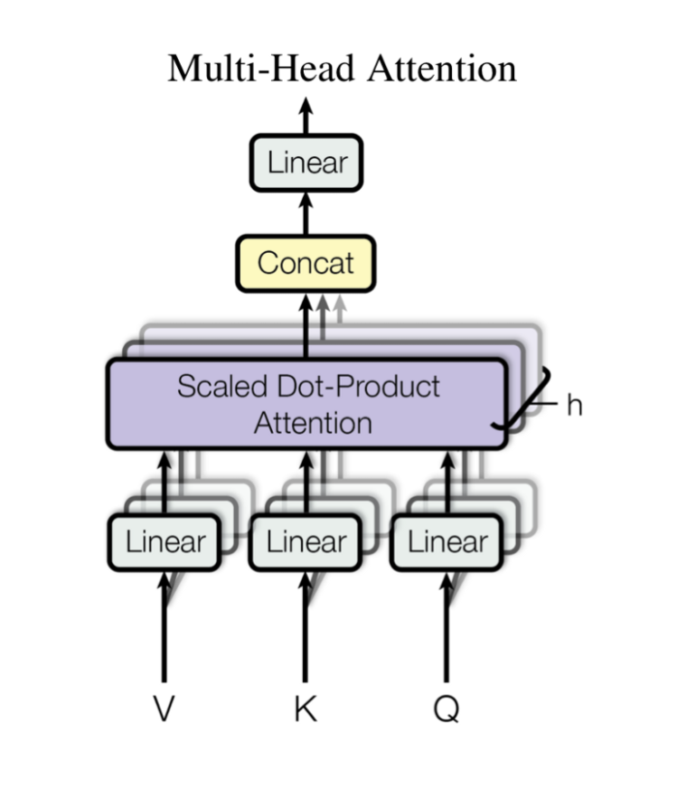
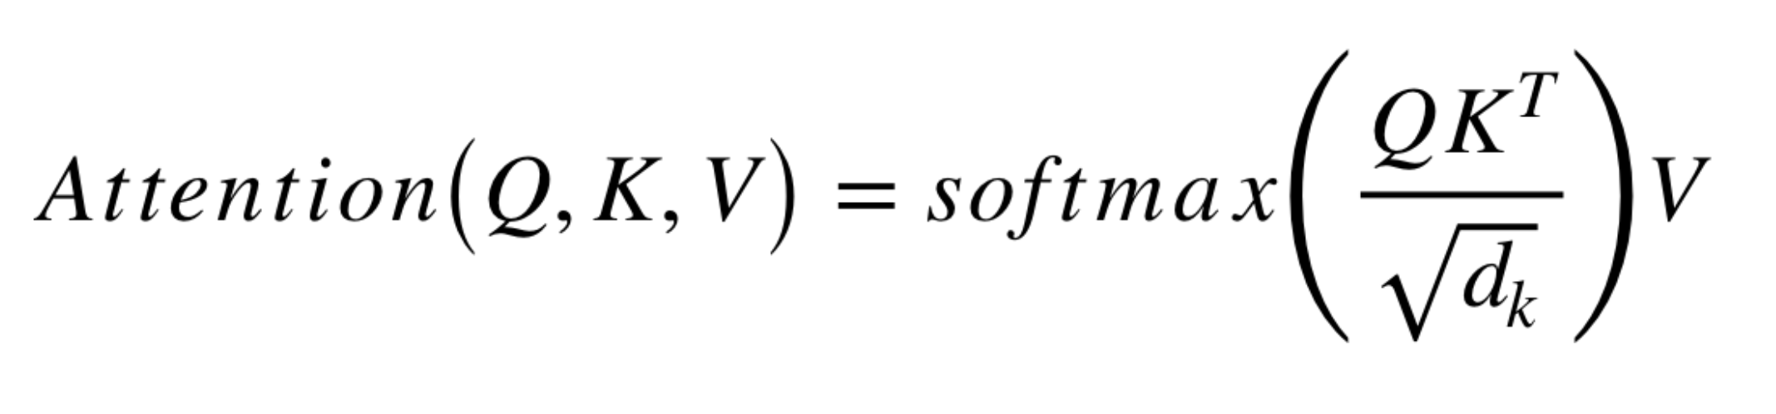
Transformer – Attention is All You Need!
The dot product in softmax below computes how each word of sequence 1 (Q) is influenced by all the other words in the sequence 2 (K).
Considering the different importance, we computed a weighted sum of the information in the sequence 2 (V) to use in computing the hidden representation of sequence 1.

Slide 31
Transformer – Attention is All You Need!
The dot product in softmax below computes how each word of sequence 1 (Q) is influenced by all the other words in the sequence 2 (K).
Considering the different importance, we computed a weighted sum of the information in the sequence 2 (V) to use in computing the hidden representation of sequence 1.

Slide 32
Transformer – Attention is All You Need!
Multiple heads!
-- Similar as how you have multiple filters in CNN
Loss of sequential order?
-- Positional encoding! (often use sine waves)

Slide 33
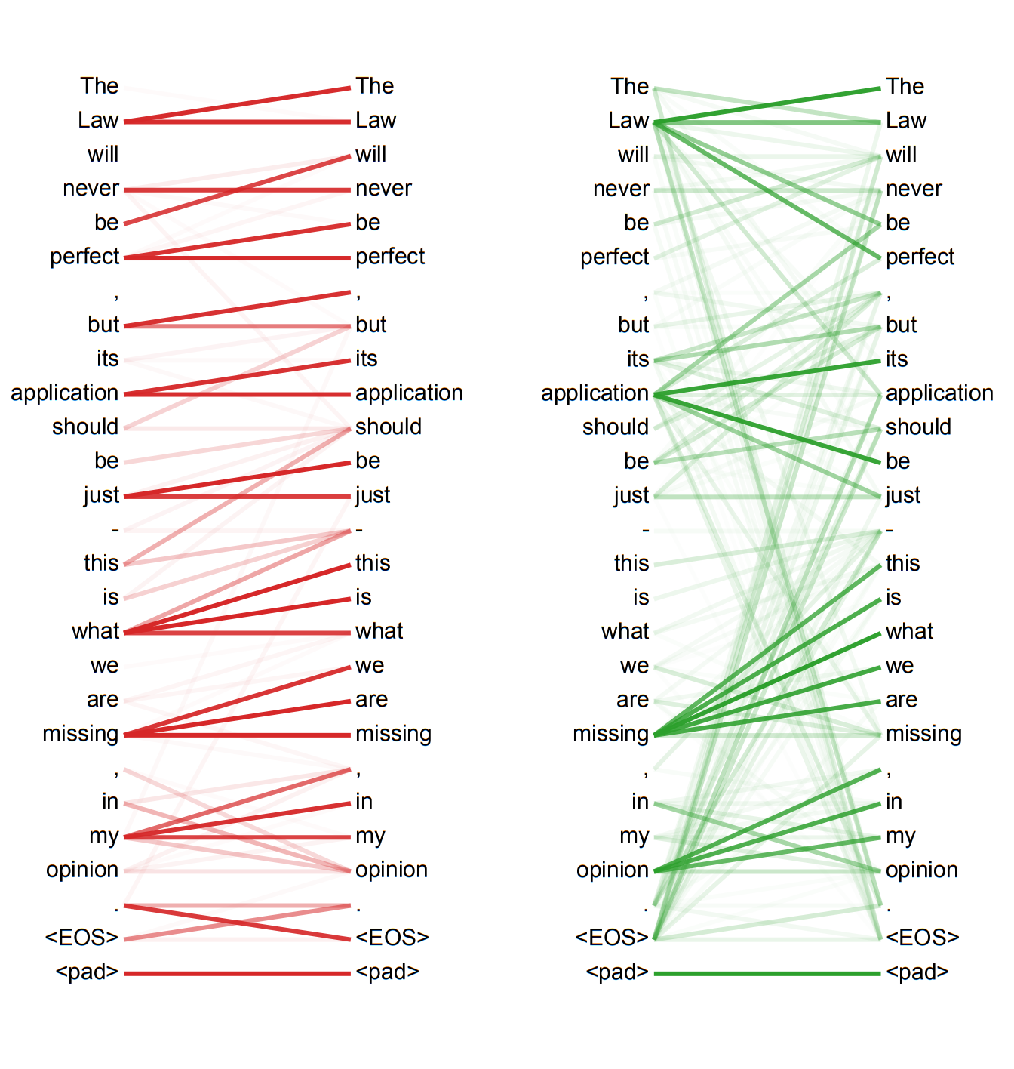
Examples of attention scores from two different self-attention heads.
References:
https://arxiv.org/pdf/1706.03762.pdf
https://medium.com/inside-machine-learning/what-is-a-transformer-d07dd1fbec04
https://towardsdatascience.com/transformers-141e32e69591
https://towardsdatascience.com/transformers-explained-visually-part-2-how-it-works-step-by-step-b49fa4a64f34

Slide 34
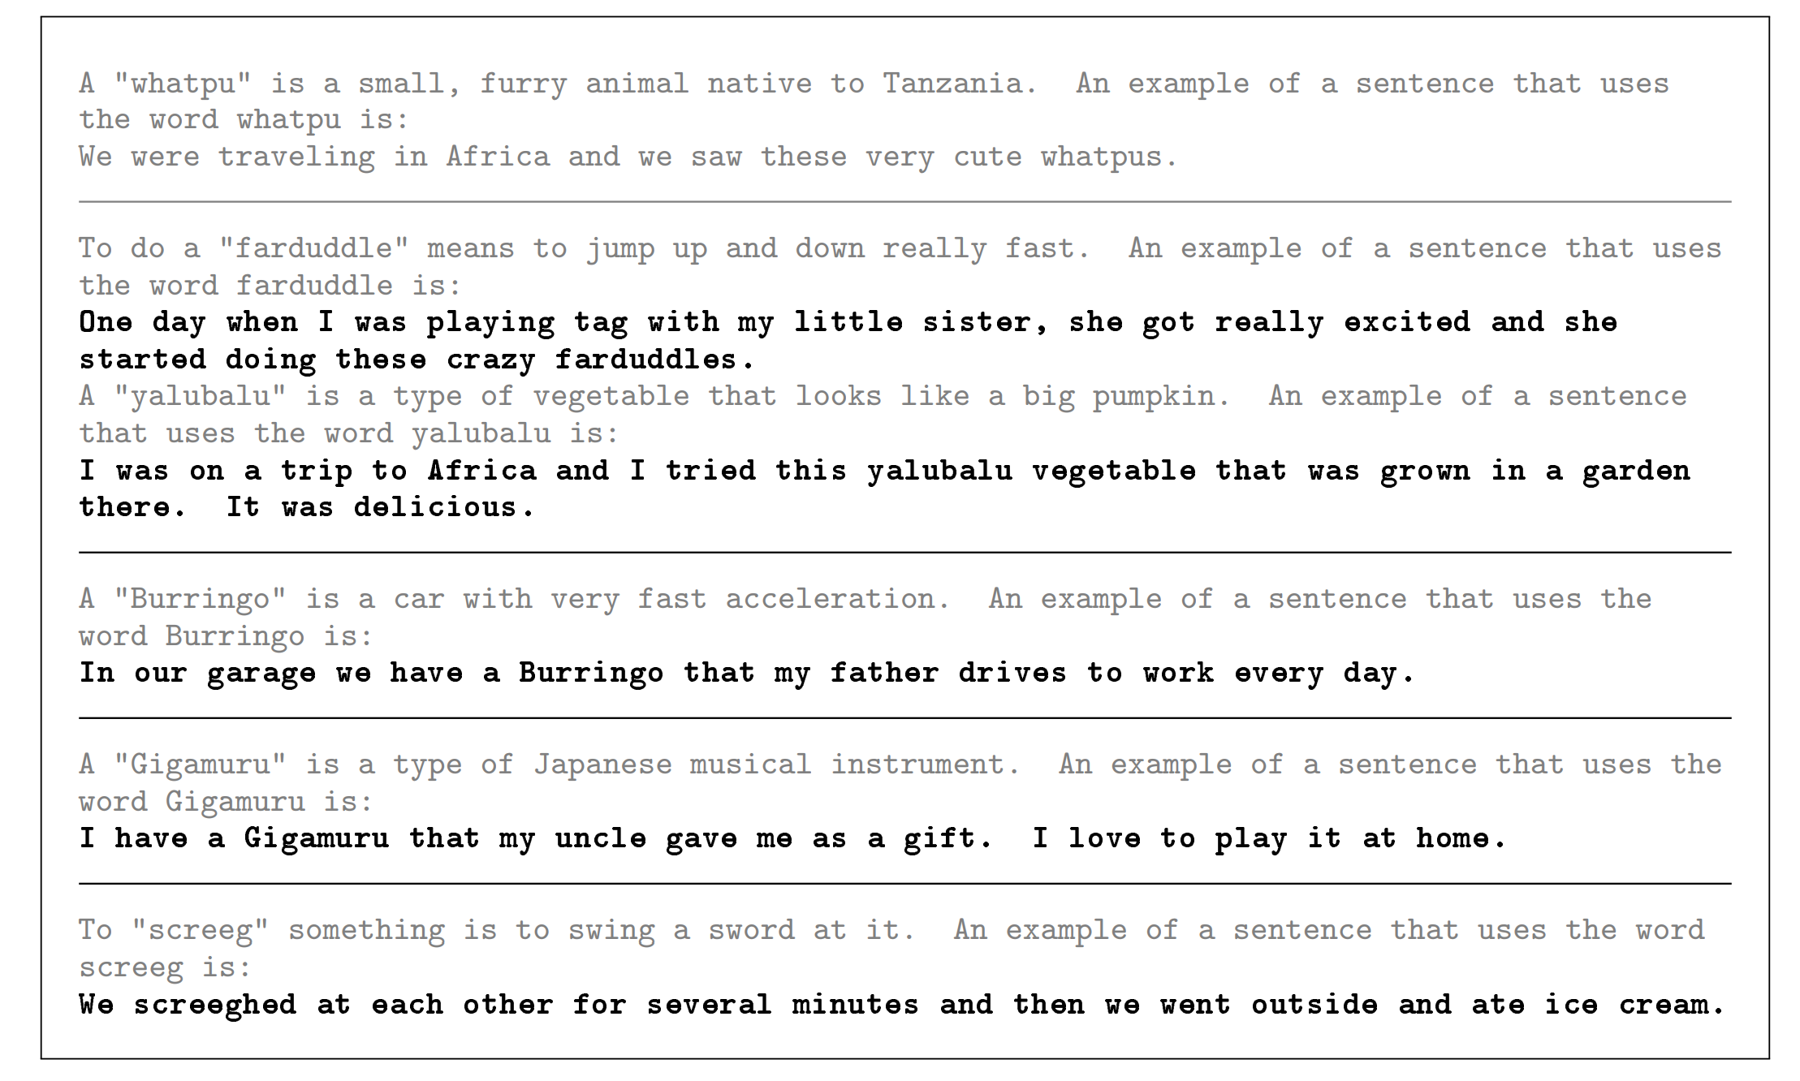
SOTA Example – GPT3

Slide 35
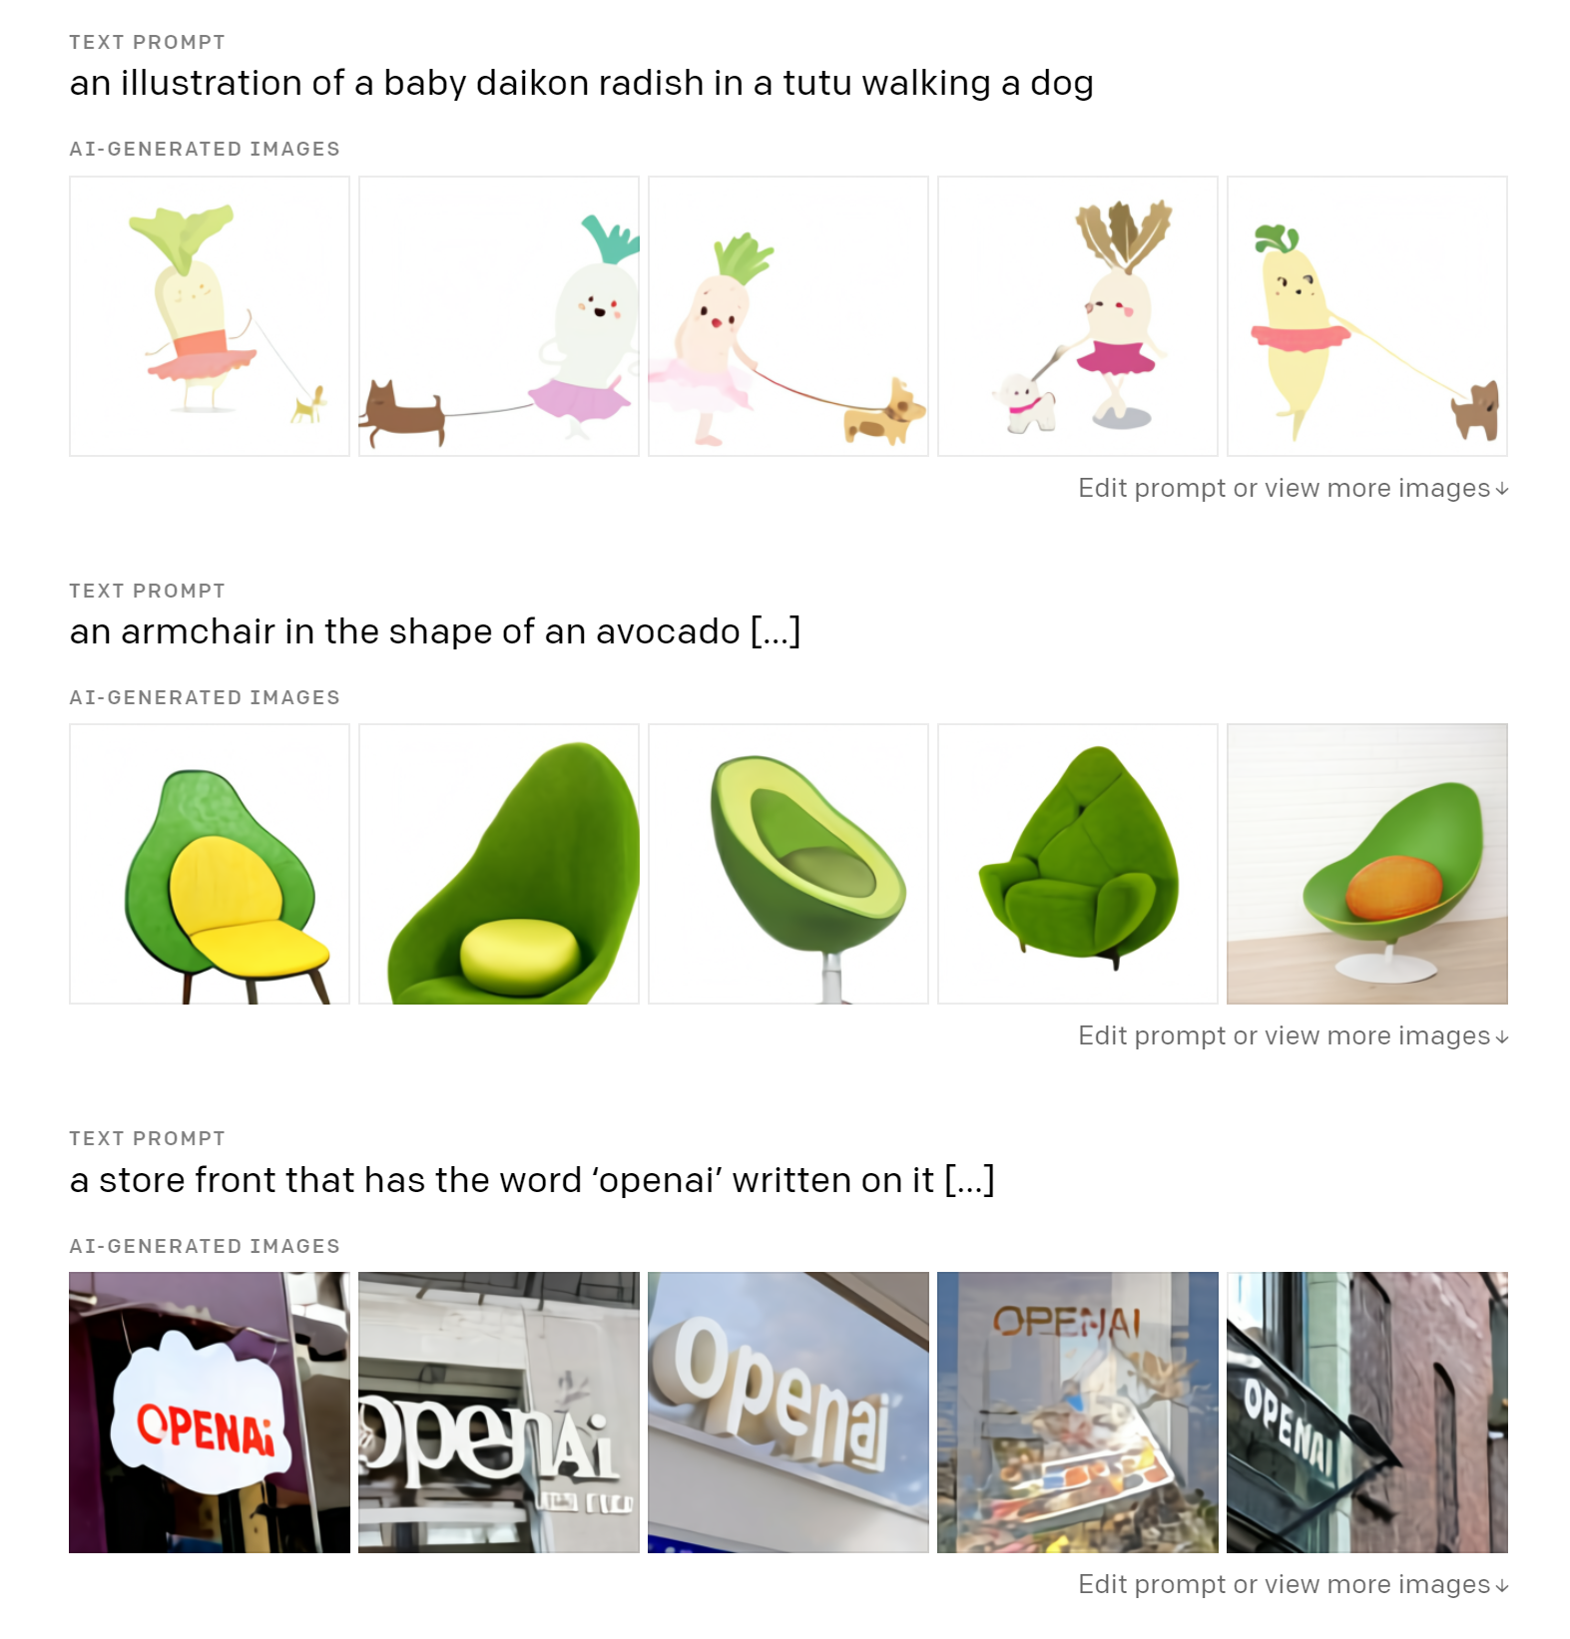
SOTA Example – DALLE

Slide 36
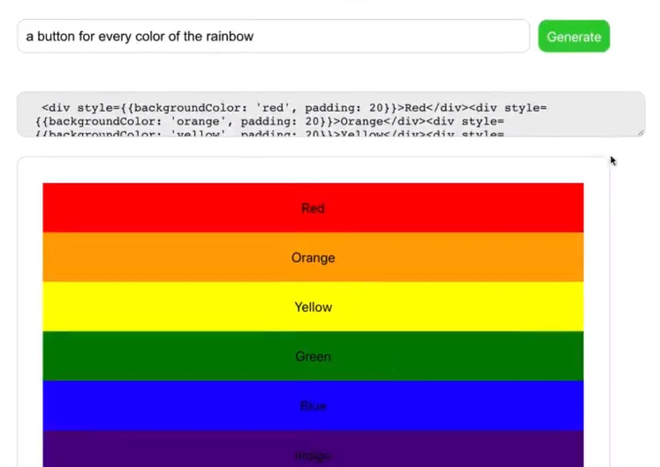
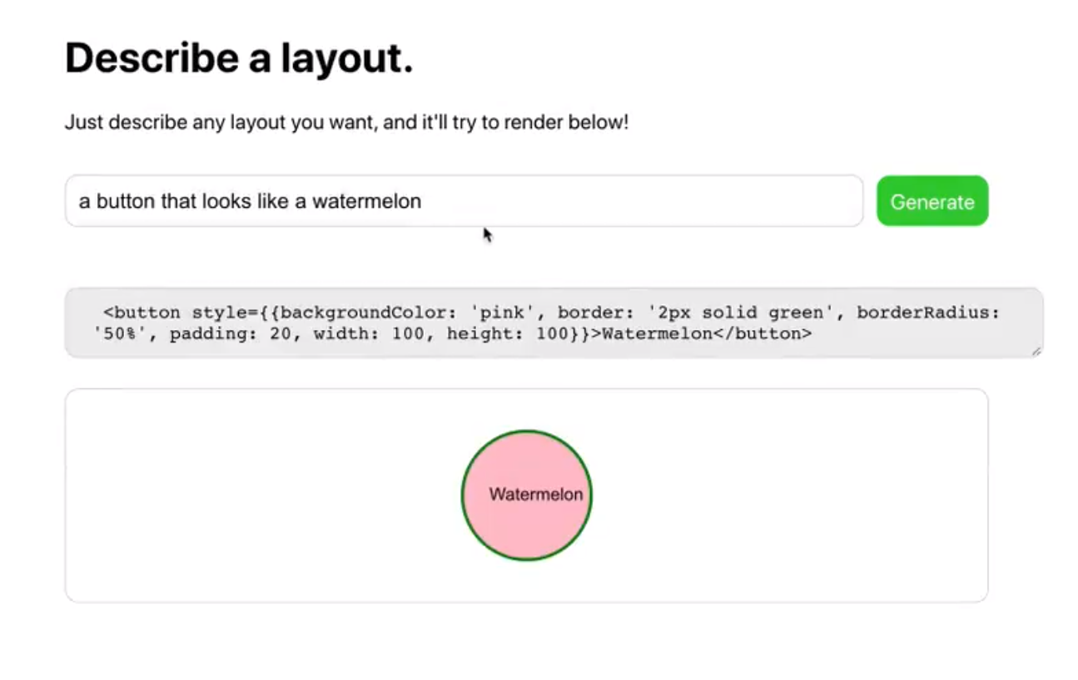
SOTA Example – GPT3

Slide 37
More? Take CS230, CS236, CS231N, CS224N
Convolutional NN
Image
Recurrent NN
Time Series
Graph NN
Networks/Relational
Deep RL
Control System

Slide 38
Not today, but take CS234 and CS224W
Convolutional NN
Image
Recurrent NN
Time Series
Graph NN
Networks/Relational
Deep RL
Control System

Slide 39



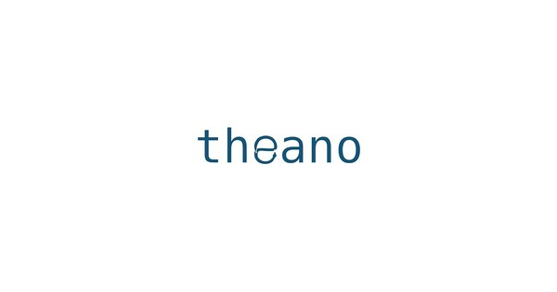



Tools for deep learning
Specialized Groups
Popular Tools

Slide 40
$50 not enough! Where can I get free stuff?
Google Colab
Free (limited-ish) GPU access
Works nicely with Tensorflow
Links to Google Drive
Register a new Google Cloud account
=> Instant $300??
=> AWS free tier (limited compute)
=> Azure education account, $200?
Azure Notebook
Kaggle kernel???
Amazon SageMaker?
To SAVE money
CLOSE your GPU instance
~$1 an hour
Notes:
https://colab.research.google.com/drive/1Enc-pKlP4Q3cimEBfcQv0B_6hUvjVL3o

Slide 41
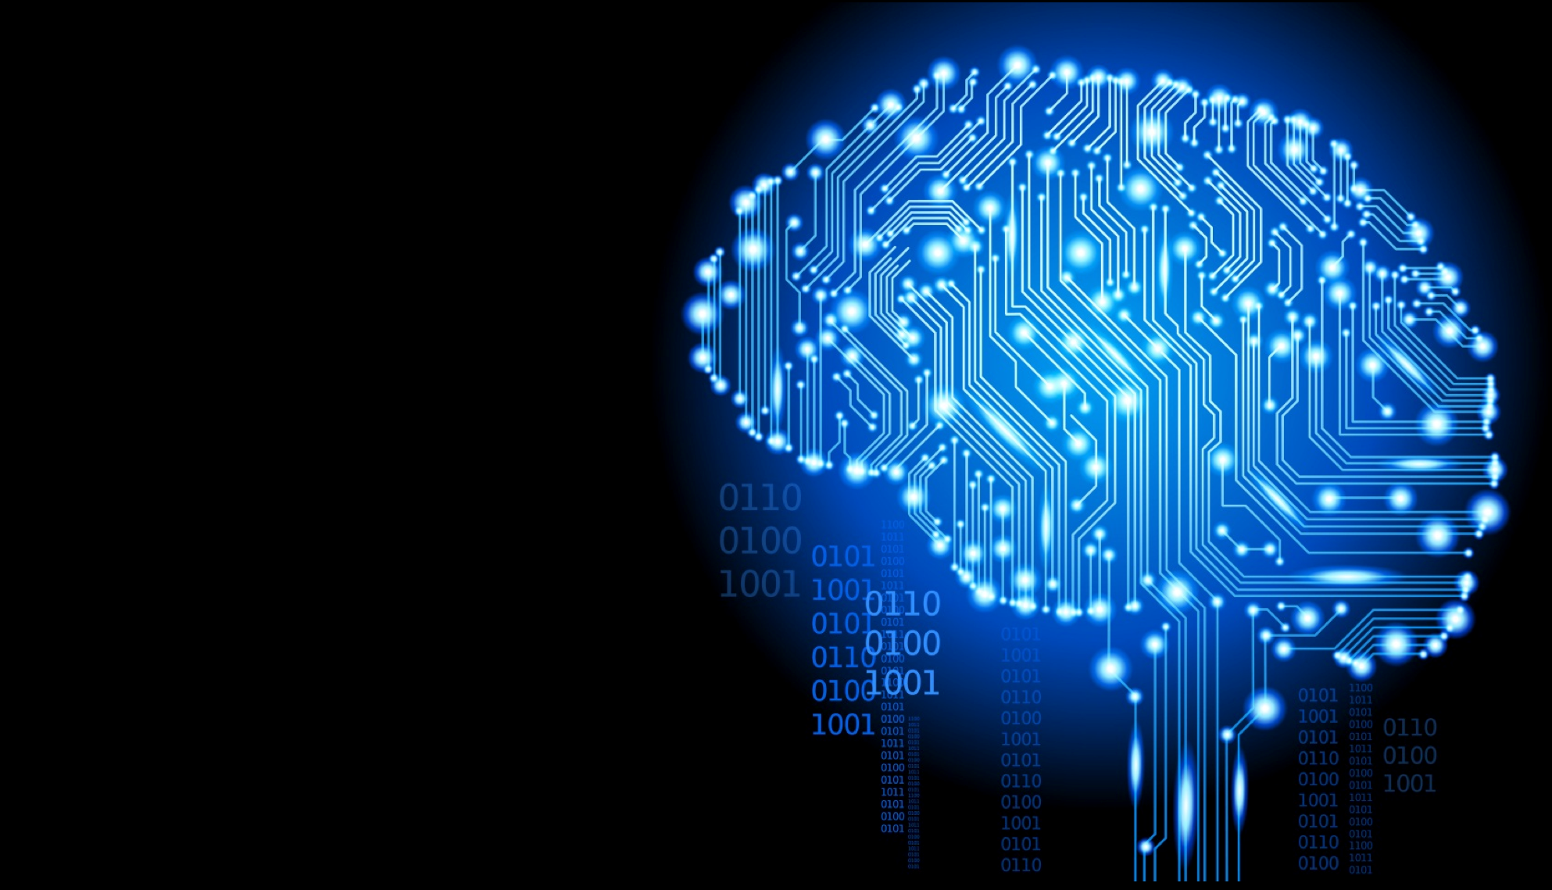
Good luck!
Well, have fun too :D

